Slide 1
Employee Data Analysis using Excel
STUDENT NAME:V.CHANDRA
REGISTER NO:312204782
USERNAME: asunm217312204782
DEPARTMENT:B.COM(COMMERCE)
COLLEGE: THIRUMURUGAN ARTS AND SCIENCE COLLEGE FOR WOMEN

Slide 2
PROJECT TITLE
Employee Performance Analysis using Excel

Slide 3


AGENDA
Problem Statement
Project Overview
End Users
Our Solution and Proposition
Dataset Description
Modelling Approach
Results and Discussion
Conclusion
3/21/2024 Annual Review

Slide 4

PROBLEM STATEMENT
The table presents the distribution of employees across different departments, categorized by employee type (Permanent and Temporary). Out of a total of 161 employees, 127 are permanent while 34 are temporary. The Business Development department has the highest number of employees (17), followed by Accounting and Legal, each with 16 employees. Departments such as Engineering, Sales, and Human Resources have fewer staff, while the "NULL" category indicates 7 employees whose department information is missing. Overall, the data reflects a workforce distribution across various functional areas.

Slide 5

PROJECT OVERVIEW
The project overview highlights the distribution of employee types across various departments. There are 161 employees in total, with 127 permanent and 34 temporary workers. Departments such as Business Development, Legal, and Product Management have higher counts, while others like Human Resources and Sales have smaller teams. Notably, Research and Development, Services, and Support also maintain substantial personnel. Additionally, seven employees have no department listed. This breakdown provides a clear view of how talent is allocated across the organization.

Slide 6

WHO ARE THE END USERS?
The end users of this data are likely HR professionals, department managers, or business analysts within the organization. They use this breakdown of employees by department and employment type (permanent or temporary) to monitor workforce composition, analyze staffing needs, and make informed decisions regarding resource allocation, recruitment, and employee management strategies. The data helps in understanding the distribution of employee types across various functional areas, ensuring operational efficiency and effective workforce planning.

Slide 7

OUR SOLUTION AND ITS VALUE PROPOSITION
Our solution provides comprehensive workforce analytics by offering clear visibility into employee distribution across different departments and employment types. For instance, in a total workforce of 161 employees, 127 are permanent and 34 are temporary, spanning departments such as Accounting, Engineering, Sales, and Marketing. This detailed breakdown enables organizations to optimize workforce planning, identify gaps, and make data-driven decisions to improve operational efficiency. By leveraging this information, companies can better manage talent and align resources with business goals, leading to improved productivity and strategic growth.

Slide 8
Dataset Description
The dataset represents the distribution of employees across various departments, categorized by their employment type (Permanent or Temporary). A total of 161 employees are accounted for, with 127 being permanent and 34 temporary. The dataset spans across key departments such as Accounting, Business Development, Engineering, Human Resources, Legal, Marketing, Product Management, Research and Development, Sales, Services, Support, and Training. There are also 7 employees with unspecified department information. This data provides insight into workforce composition and departmental staffing.

Slide 9

THE "WOW" IN OUR SOLUTION
Our solution highlights a dynamic workforce comprising 161 employees, with 127 permanent and 34 temporary team members across various departments. Key areas like Accounting, Legal, and Business Development are among the largest, while diverse functions such as Engineering, Marketing, and Sales drive core operations. With a broad talent pool spanning Research and Development, Product Management, and Support, we ensure robust organizational support. This versatile team structure enables us to deliver high-quality services and innovative solutions across the board.
3/21/2024 Annual Review
9

Slide 10
MODELLING
The provided data outlines the distribution of employees by department and employee type, categorized as either "Permanent" or "Temporary." Out of a total of 161 employees, 127 are permanent and 34 are temporary. Departments like Business Development and Accounting have a relatively high number of employees, with 17 and 16 employees, respectively. Notably, Research and Development, Product Management, and Support also have significant headcounts. Some departments, such as Training, have a higher proportion of temporary employees compared to others. Additionally, 7 employees have no department designation, labeled as "NULL." Overall, this data reflects a diverse workforce distribution across various departments.
10

Slide 11
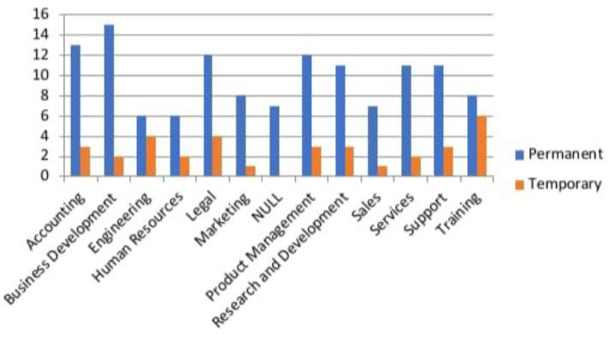
RESULTS
11

Slide 12
conclusion
The data provides an overview of employee types across various departments. Permanent employees are predominant in all departments, with a total of 127 out of 161 employees. Temporary employees are less common, with 34 in total. The departments with the highest number of employees are Accounting, Business Development, and Legal. The "NULL" category, which likely represents unspecified or unknown departments, includes 7 employees. Overall, the distribution reflects a higher reliance on permanent staff compared to temporary positions across the organization.

